Slide 1
Health Effects on Physical Body due to micro-gravity and stellar radiations

Slide 2
Space Adaptation Syndrome
More than half of astronauts experience Space Adaptation Syndrome (SAS) commonly referred to as space sickness. SAS is a result of the human body suffering from spatial disorientation due to the transition into weightlessness. The vestibular system in the inner ear becomes confused by the lack of gravity, and the lack of a defined up and down. The effects can vary from mild nausea and discomfort to vomiting and intense headaches

Slide 3
EYE PROBLEMS
Conditions called as 'visual impairment intracranial pressure' syndrome, or VIIP, and the leading hypothesis is it's being caused by the lack of gravity causing pressure to build up in astronauts' head.
On Earth, gravity pulls fluid towards our feet, but in space, that doesn't happen they tend to move up to the skull due to micro-gravity.
All of this extra fluid in the skull could be putting pressure on the back of the eyeballs, causing them to flatten, and pushing the retinas forward to distort vision - at least that's what scientists think is happening.
The problem is that while scans have confirmed the eye-flattening part of things, the only way to monitor intracranial pressure is to perform a spinal tap or drill a hole in someone's head - both options that aren't ideal in space.

Slide 4
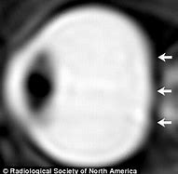
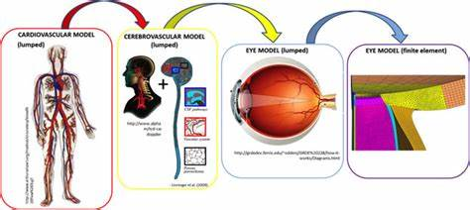
Visual impairment intracranial pressure syndrome

Slide 5
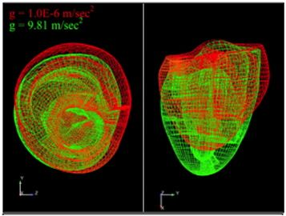
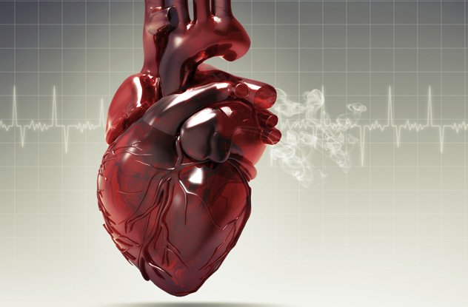
Cardiac Problems
When astronauts spend long periods of time at zero gravity in space, their hearts become more spherical and lose muscle mass, a new study finds, which could lead to cardiac problems. The spherical shape of the heart could mean the heart is functioning less efficiently. The condition appears to be temporary — the astronauts' hearts returned to a normal elongated shape after they return to Earth.

Slide 6
Puffy Faces and Skinny Legs:-
Puffy face and skinny leg syndrome is something that is experienced when living in space. This is a result of fluid changes in the body, especially within the first couple of days of entering the microgravity environment. On Earth the heart has to pump blood against gravity, to get blood to the upper half of your body it must work harder. In space there is no gravity to pull fluids down, they remain in the upper half of the body causing puffy face and skinny leg syndrome until the body readjusts.

Slide 7
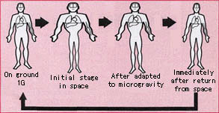
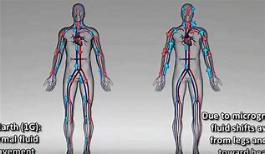
Shift in body fluid due to micro - gravity

Slide 8
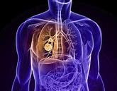
Problems in lungs due to cosmic dust
The most dangerous effect may be on the lungs if the fine particulates of moon dust are inhaled. Extremely sharp-edged moon dust can harm the heart and lungs, with effects ranging from inflammation to a heightened risk of cancer. It’s somewhat like inhaling asbestos.
This sharp-edged dust can also cause irritation and abrasions on skin. In fact, it’s been known to wear through multiple layers on a boot of Kevlar-like material. Lunar dust can also scratch the cornea of an astronaut’s eye, causing an especially serious emergency in space.

Slide 9
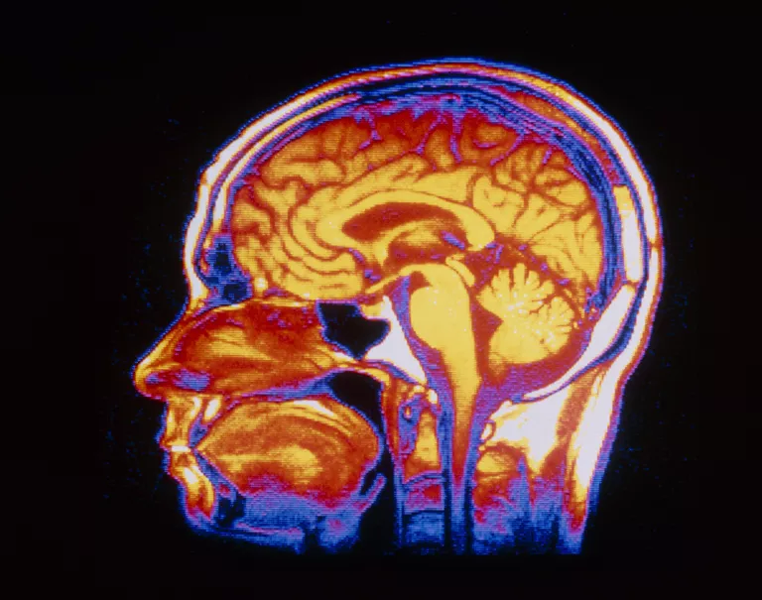
Cognitive problems due to stellar radiations
When simulating deep space conditions, scientists discovered that exposure to high-energy particles, even in low doses. biological marker to predict which astronauts will experience these effects. Then they might be able to lessen the effects of radiation for those people.
A more serious concern is Alzheimer’s. “Exposure to radiation levels equivalent to a mission to Mars could produce cognitive problems and speed up changes in the brain that are associated with Alzheimer’s disease

